Slide 1
Cornerstone City Church Peninsula Plus Community Hoo Are Ya
5th May 2024

Slide 2


Slide 3
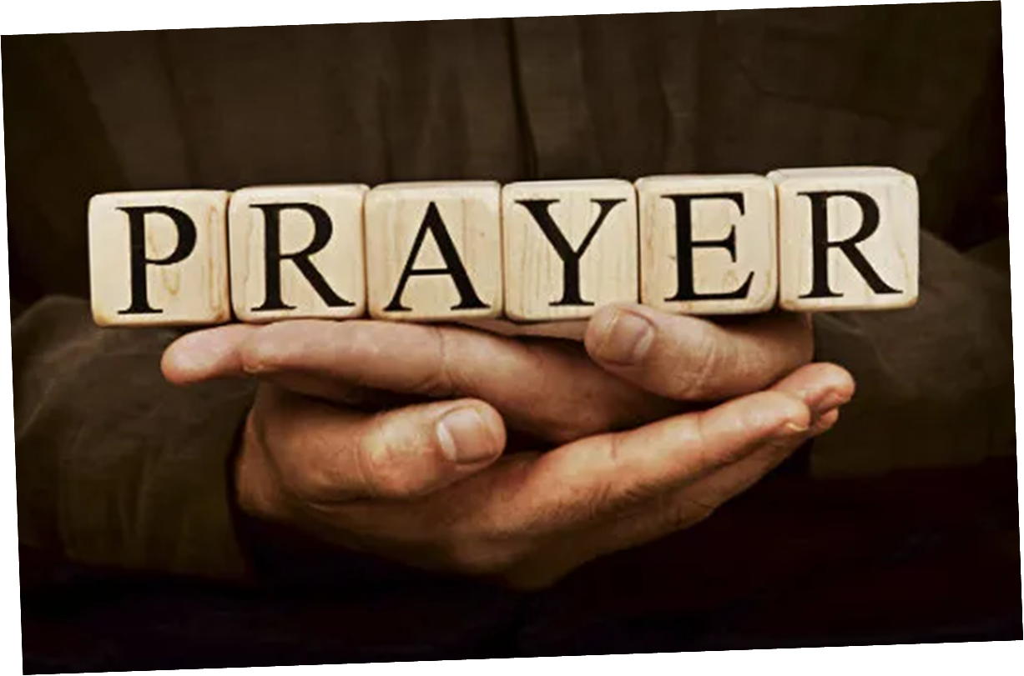

Slide 4


Slide 5
This is Our God
CCLI Song # 7211413
Brandon Lake | Pat Barrett | Phil Wickham | Steven Furtick
© Brandon Lake Music; Phil Wickham Music; Simply Global Songs; Capitol CMG Genesis; Housefires Sounds; Music by Elevation Worship Publishing
For use solely with the SongSelect® Terms of Use. All rights reserved. www.ccli.com
CCLI Licence No. 33265

Slide 6
1/7
Remember those walls that we called sin and shame
They were like prisons that we couldn’t escape
But He came and He died and He rose
Those walls are rubble now

Slide 7
2/7
Remember those giants we called death and grave
They were like mountains that stood in our way
But He came and He died and He rose
Those giants are dead now

Slide 8
3/7
This is our God this is who He is
He loves us
This is our God this is what He does
He saves us
He bore the cross beat the grave
Let heaven and earth proclaim
This is our God King Jesus

Slide 9
4/7
Remember that fear that took our breath away
Faith so weak that we could barely pray
But He heard every word every whisper
Now those altars in the wilderness
Tell the story of His faithfulness
Never once did He fail and He never will

Slide 10
5/7
Who pulled me out of that pit
He did He did
Who paid for all of our sin
Nobody but Jesus

Slide 11
6/7
Who rescued me from that grave
Yahweh Yahweh
Who gets the glory and praise
Nobody but Jesus (Him)

Slide 12
7/7
He bore the cross beat the grave
Let heaven and earth proclaim
This is our God King Jesus

Slide 13
Ancient Of Days
CCLI Song # 798108
Gary Sadler | Jamie Harvill
© 1992 Integrity's Hosanna! Music
For use solely with the SongSelect® Terms of Use. All rights reserved. www.ccli.com
CCLI License # 33265

Slide 14
1/3
Blessing and honor glory and power
Be unto the Ancient of Days
From ev'ry nation all of creation
Bow before the Ancient of Days

Slide 15
2/3
Ev'ry tongue in heaven and earth
Shall declare Your glory
Ev'ry knee shall bow at Your throne
In worship
You will be exalted O God
And Your kingdom shall not pass away
O Ancient of Days

Slide 16
3/3
Your kingdom shall reign
Over all the earth
Sing unto the Ancient of Days
For none can compare
To Your matchless worth
Sing unto the Ancient of Days

Slide 18


Slide 19
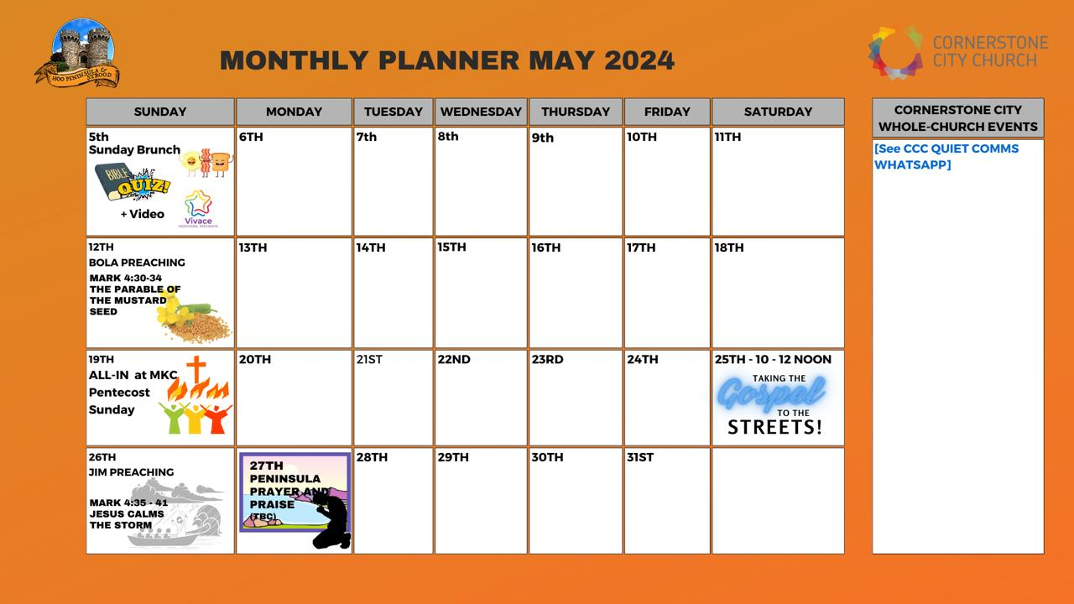

Slide 20


Slide 21


Slide 24
2 Corinthians 14 May the grace of the Lord Jesus Christ, and the love of God, and the fellowship of the Holy Spirit be with you all

